Slide 1



Sushi Samurai
Coding: Paul Caldwell & Christian Mejia
Graphics: Jerrod Tanner & Jordan Sterling

Slide 2

The App
Our game is centered around a Samurai, from a village, who is attempting to collect sushi from shark invested waters.
Our game is a single player, endless running game.
The game is simple to play: run, jump and collect the sushi.

Slide 3
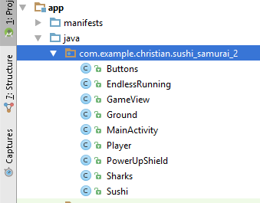
Coding
Each Java class was created upon the attributes that we wanted within the game.
For example, the java class player “Player” consists of the code that involves the actual character.
Our code is based upon a tutorial from a video called “How to Create an Endless Running Game on Android Studio.”
Our code was actually written by Paul and Christian; it was then edited based off the tutorial to make our own app.

Slide 4
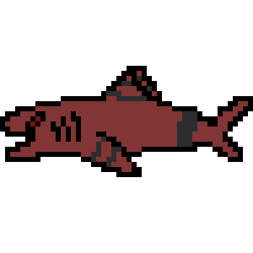
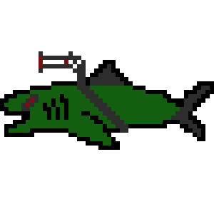
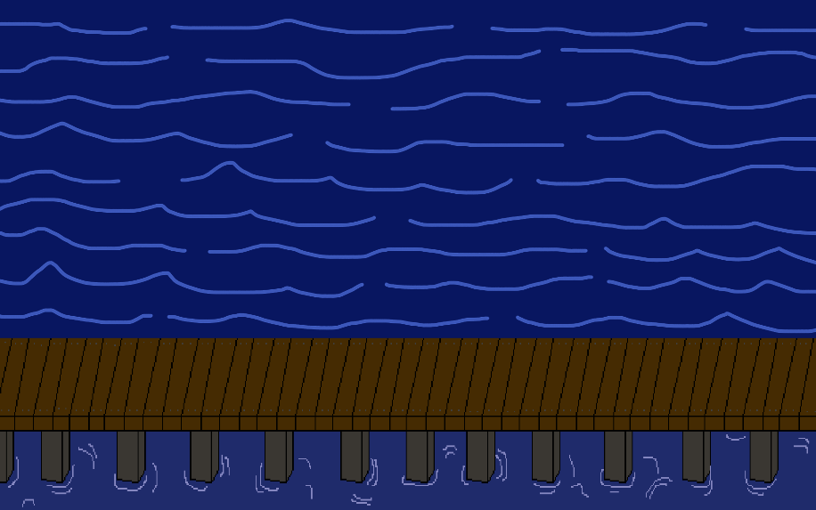
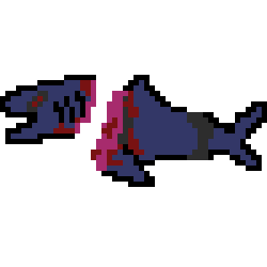
Graphics
The sushi, ocean background, and main sharks images were created by Jerrod Tanner. However, some animations of the sharks were not incorporated into the game.
All pixel animations of the Samurai were created by Jordan Sterling. However, some animations of the samurai were not incorporated into the game.

Slide 5

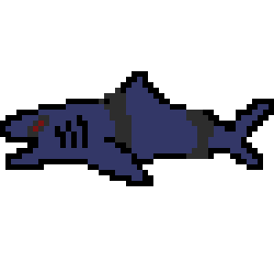
Future Additions
The addition of more customizable players.
The ability to perform more actions like duck and slash.
The interaction of the blade with the sharks, resulting in the sharks transforming into sushi.
Possibly the addition of different levels which will include different colored sharks and backgrounds.

Slide 6

Credits
All Graphics: Jerrod Tanner & Jordan Sterling
All Android Studio Coding: Paul Caldwell & Christian Mejia
PowerPoints: Christian Mejia
Processing/Sensor : Paul Caldwell
Promotional Video: Paul Caldwell & Jerrod Sterling
Android Studio Tutorial: Linus Granath

